Slide 1
Chef Activity Badge

Slide 2
Safety and Hygiene in the Kitchen
Can you name any rules of safety and hygiene?

Slide 3
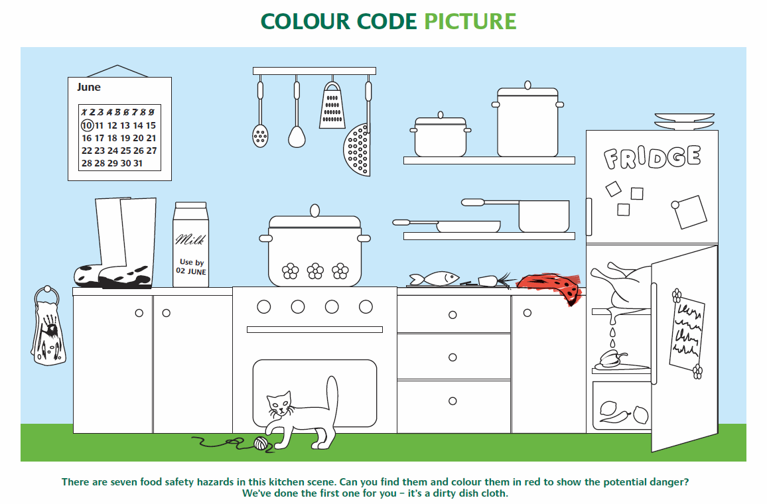
What are the hazards in this kitchen?

Slide 4
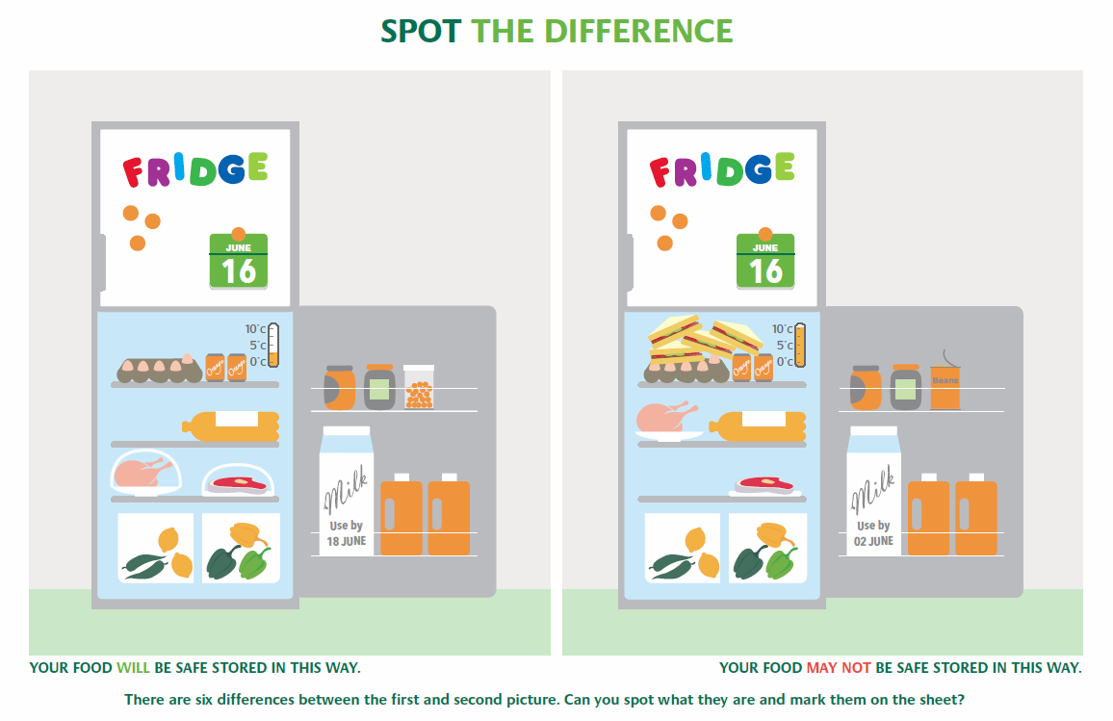
Spot the difference and the problems in the fridge on the right

Slide 5
Safety in the Kitchen
Always store food in the correct places. For example raw meat and fish should be covered and stored on the bottom shelf to avoid raw juices dripping on the food.
Always wash hands thoroughly with warm soapy water, rinse and dry well before preparing food. It is very important to wash your hands especially after handling raw meat.
Surfaces should be thoroughly cleaned.
Always check use by dates before using food. If it is past it’s date do not use it as it may be unsafe to eat.
Always use a chopping board, and always wash the board when switching between raw meats and ready-to-eat foods.
Always cook food until it is steaming hot in the middle to kill all bacteria.

Slide 6
What are the different ways of cooking?

Slide 7
The Different Ways of Cooking
Boiling - You can cook food in water and bring it to the boil or start to cook once your water has boiled. However, if you cook food in water, you have to keep an eye on the clock because if you cook it too long it will lose flavour, texture, vitamins and minerals
Microwaving – This is very popular for cooking and reheating a variety of foods and ready meals.
Baking – This is cooking food with a dry heat in the oven. This is mainly for baking cakes and bread.
Grilling – This can be done on a grill or over a barbecue. Unlike frying, grilling meats is done without oil. However eating grilled foods is not very good for our health.
Steaming – Steaming is the best way to make sure your food keeps its flavour, vitamins and other nutrients. This is great for green vegetables, fresh fish or chicken.
Roasting – Roasting keeps the nutrients in and is ideal for good quality meat joints and fish. If you roast meats too fast or too long it will make your food dry and chewy.

Slide 8
What are the major food groups?

Slide 9
The Food Groups
Fruit and Vegetables - These are full of vitamins and minerals that help protect the body from illness. Examples are apples, bananas, peas, carrots and broccoli.
Carbohydrates - They help fuel the body by giving us energy. Examples are potatoes, pasta, rice and bread.
Dairy foods – These foods contain calcium and calcium strengthens our bones and teeth. Examples are milk, cheese yoghurt and butter.
Protein – Protein helps build and repair cells and muscles. Examples are chicken, beans, meat, fish and eggs.
Fats – Fats give the body energy for growth. However, we should not eat too much or it can be unhealthy. Examples are cake, chips chocolate and crisps.

Slide 10
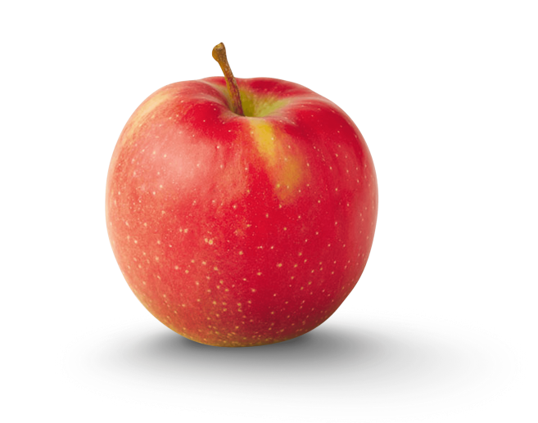
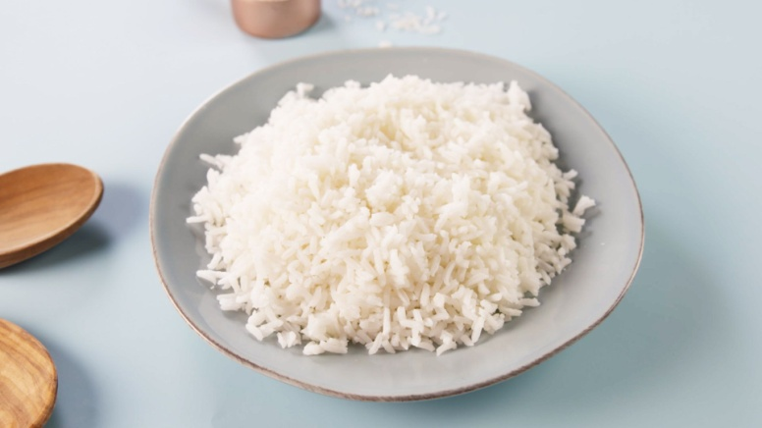
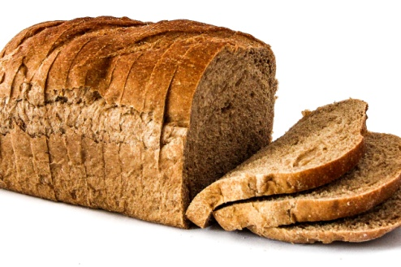
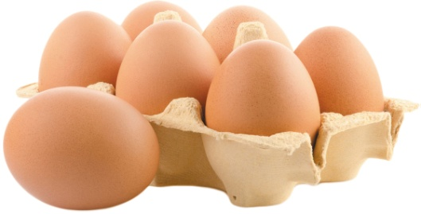
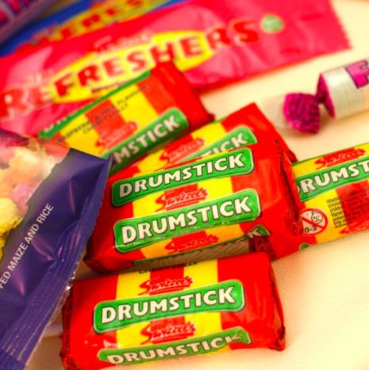
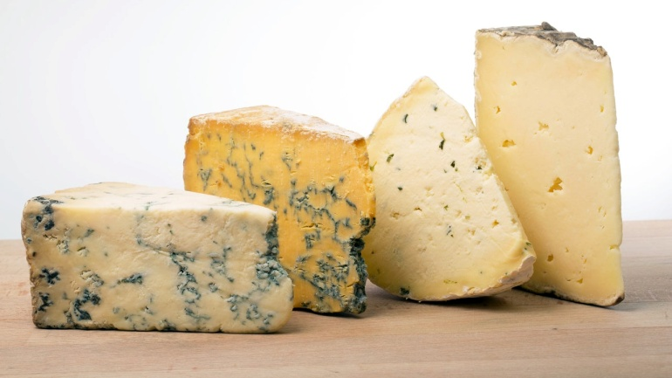
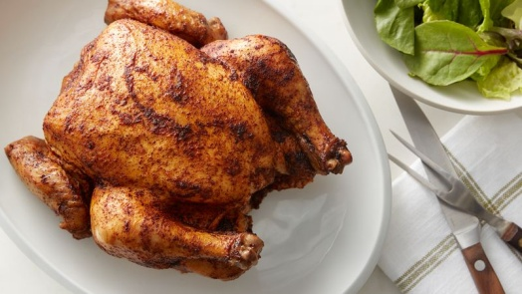
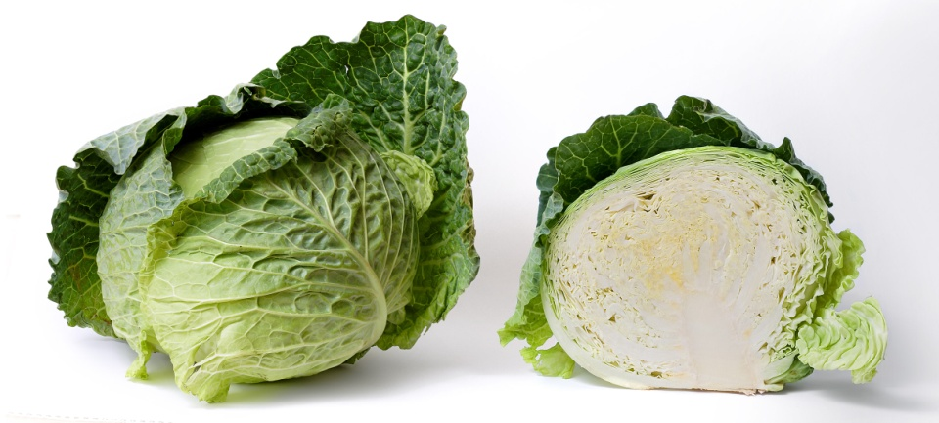
Which food is from which food group?

Slide 11
Answers on the next slides…..

Slide 12
