Slide 1
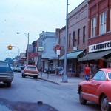
Road Safely Badge
This Photo by Unknown Author is licensed under CC BY-NC

Slide 2
10 different traffic signs. Explain what they mean.

Slide 3
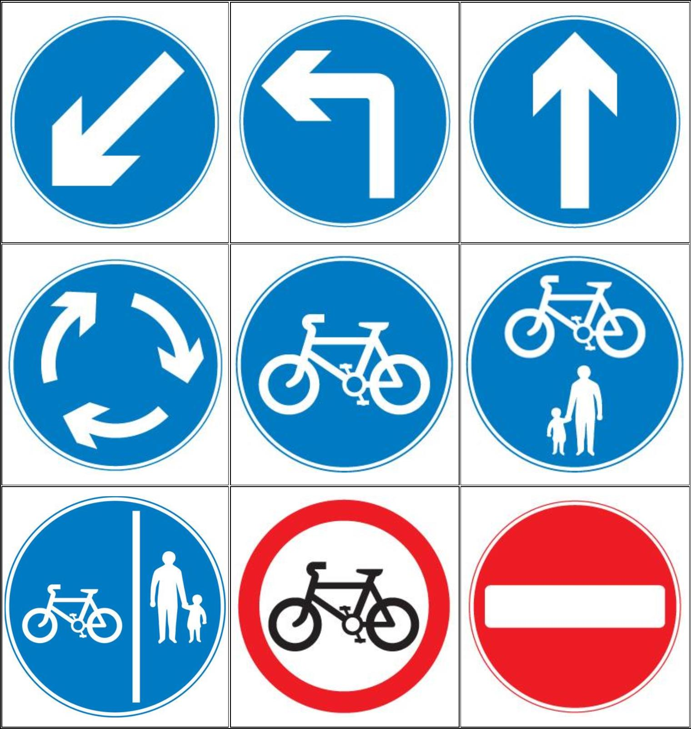
A Route to be used by pedal cycles only | No cycling | Keep left
Shared pedal cycle and pedestrian route | Segregated cycle and pedestrian route | Mini roundabout
Turn left ahead | No entry for vehicles | Ahead only
B
1
2
3
A
C
4
5
6
D
E
F
7
8
G
H
I
9

Slide 4
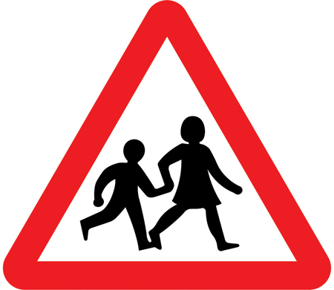
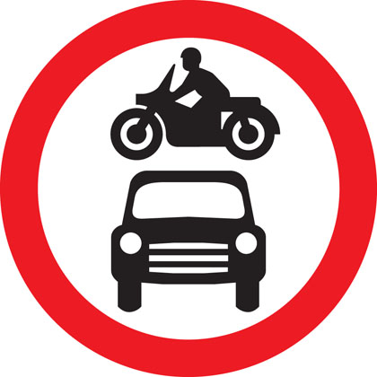
1 | 2 | 3 | A No through road for vehicular traffic | B Double bend or series of bends ahead, first to the right | C Level crossing with gate or barrier ahead
4 | 5 | 6 | D Opening or swing bridge ahead | E Give way to traffic on the major road | F Traffic signals ahead
7 | 8 | 8 | H Maximum speed limit of 40 miles per hour | G Children crossing | I No motor vehicles

Slide 5
Which of these is NOT a safe place to cross?
A/ Zebra crossing
B/ On a blind bend
C/ Puffin crossing
D/ Lollipop lady

Slide 6
Show how to use
the Green Cross Code.

Slide 7
Where should you stand before crossing the road?
A/ On the road
B/ Next to the traffic
C/ On the pavement, near the kerb
D/ Behind a bush

Slide 8
Where should you look first before crossing the road?
A/ To the left hand side
B/ To the right hand side
C/ Straight ahead
C/ Behind you

Slide 9
What is step three of the Green Cross Code?
A/ Look
B/ Cross
C/ Wait
D/ Stop

Slide 10
If traffic is coming what should you do?
A/ Put your hand out and stop it
B/ Start crossing the road and the cars will stop
C/ Stand in the middle of the road for it stop
D/ Let it pass

Slide 11
What else should you do if you can't see traffic?
A/ Sing
B/ Dance
C/ Listen
D/ Think

Slide 12
At which crossing should you wait for the green man to show?
A/ Puffin
B/ Zebra
C/ Lollipop lady
D/ Footbridges

Slide 13
In which direction should you cross the road in?
A/ Diagonally
B/ Backwards
C/ Straight
D/ Zig Zag

Slide 14
Who should you look out for as you may not hear them?
A/ Adults
B/ Cyclists
C/ Babies
D/ Animals

Slide 15
What should you do if there is no pavement for you to stand on?
A/ Keep back from the edge of the road
B/ Stand as close to the traffic as possible
C/ Cross as fast as you can
D/ Go back home

Slide 16
Tell a leader why it’s important to have different types of pedestrian crossing. Explain how to use them safely.

Slide 17
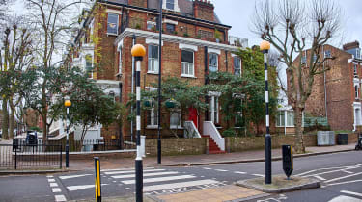
Zebra crossing rules and how to use one
This is the only type of crossing where pedestrians automatically have right of way. Drivers should look for people either standing at the kerb looking to cross, or already walking on the crossing, and stop to let them cross, waiting for them to reach the other side of the road before continuing.
• What is the highway code and how to learn it
But, even though pedestrians have priority, they should still take care and wait for traffic to stop before stepping on to the crossing.

Slide 18
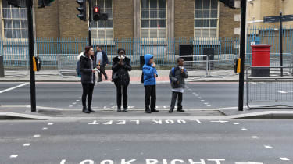
Pelican crossing rules and how to use one
Pedestrians who wish to cross the road must press a button on a black and yellow box. The ‘WAIT’ sign illuminates on the box when the button is pushed, and goes out once the traffic lights change. A green man (and/or woman) sign on the opposite side of the road confirms it is safe for pedestrians to cross.

Slide 19
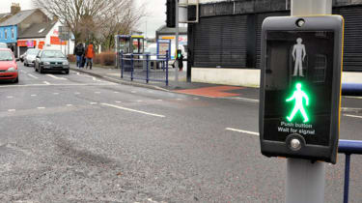
Puffin crossings might look similar and work in a similar way to pelican crossings, but there are some key differences to be aware of. Pedestrians will still see a black and yellow box with a button on it, and drivers will see normal traffic lights, but puffin crossings do not have the green and red man mounted high up next to the vehicle traffic lights.
Instead, the red and green man pedestrian crossing symbols are displayed on the yellow and black box with the crossing demand button.

Slide 20
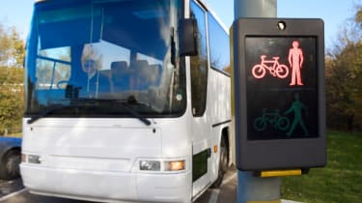
A toucan crossing works in a similar way to a puffin crossing, using sensors to detect when there are people waiting to cross or already crossing the road.
• Hazard Perception test tips
The key difference is a toucan crossing means “two can” cross – both pedestrians and cyclists are allowed to use the crossing to get from one side of the road to the other.
Toucan crossing rules and how to use one
Drivers should behave at toucan crossings in much the same way they would at pelican and puffin crossings.
Toucan crossings tend to be wider than pelican or puffin crossings in order to accommodate cyclists. They also feature an additional green signal for cyclists alongside the pedestrian one, although the two are synchronised with each other.

Slide 21
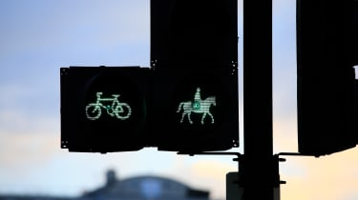
Pegasus crossing rules and how to use one
Treat Pegasus crossings in the same way you would puffin, toucan and pelican crossings – but don’t be surprised to see a horse crossing the road.

Slide 22
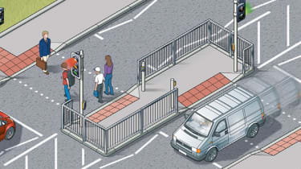
A pedestrian refuge ­is an “island” in the middle of the road that makes it safer for people to cross roads that are not fitted with pedestrian crossings.
Although this itself is not a type of pedestrian crossing, staggered crossings are and work on a similar basis.
Staggered crossings rules and how to use one
Here, pedestrians are required to cross the road in two stages, pushing a button to activate a signal that lets them cross to a large “island” in the centre of the road and then doing the same to use a second crossing that lets them get the rest of the way across the road.
These staggered setups are usually found on carriageways with multiple lanes, where one side may be following a difference traffic light phase than the other. While they can combine pelican, puffin and toucan crossings, they should be treated as two separate crossings.

Slide 23
Show that you know how to behave safely as a car passenger

Slide 24
Drivers need to concentrate and distractions within the car can make
this difficult. Here are a few tips for being a good passenger:
wear your seat belt at all times
be a 'good co-pilot', for example, support the driver in ensuring that other passengers act responsibly - offer to help navigate, keep the radio volume at a reasonable level and don’t ‘channel jump’
try to keep all interactions to a reasonable level - the more people in the car, the more distractions there may be from conversations, music, people using mobile phones
if you pay attention to the road you will be able to see when a driver may need to concentrate more and could help the driver’s focus by, for example, pausing a conversation or turning down the radio
if you think there is an emerging danger do let the driver know - but do not shout or try to grab the steering wheel or hand brake
at night, don’t turn on interior lights while the car is moving as this can affect the driver's night vision
don’t be a ‘back-seat driver’ - you can give the driver helpful information but refrain from being negative or giving a critical or 'witty' commentary on how they are driving, particularly if they are inexperienced

Slide 25
Answers
1 – C
2 –G
3 –I
4 – F
5 – A
6 – D
7 – E
8 – B
9 - H
1 –G
2 – H
3 – E
4 – C
5 – F
6 – A
7 – D
8 – I
9 - B
Green Cross Code
B
C
B
A
D
C
A
C
B
A

