Slide 1
Cubs
Fire Safety
Activity Badge

Slide 2
Virtual Fire Station Tour Role of a Fireman
responding immediately and safely to emergency calls and requests for assistance
attending emergency incidents including fires, road accidents, floods, terrorist incidents, spillages of dangerous substances, and rail and air crashes
rescuing trapped people and animals
minimising distress and suffering, including giving first aid before ambulance crews arrive
cleaning up and checking the site after dealing with an incident
inspecting and maintaining the appliance (fire engine) and its equipment, assisting in testing fire hydrants and checking emergency water supplies
educating and informing the public to promote fire safety, by giving talks in schools, local organisations and completing home visits to offer advice
maintaining links with the local community.
https://www.youtube.com/watch?v=TU1DDTtVfvc&feature=youtu.be

Slide 3
Practice Fire Drills With Your Family

Slide 4
Plan your escape
Make an escape plan and practise it regularly to make sure everyone knows how to get out safely
The best route is the normal way in and out of your home
Plan a second route in case the first one is blocked
Never store anything in communal areas including balconies. Items can block your escape route and be a fire risk
Always keep door and window keys where everyone you live with can find them
Do Not Start Collecting thing GET OUT
Do Not Re-Enter the Building

Slide 5
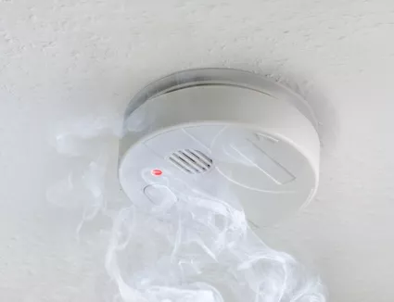
A smoke detector is a device that senses smoke, typically
as an indicator of fire. Test weekly and change the battery yearly
What to do on hearing the smoke detector
Wake everyone up
Using your Fire Drill Get everybody Out
Ring 999

Slide 6
Ask Cubs For Possible Dangers in their Home

Slide 7
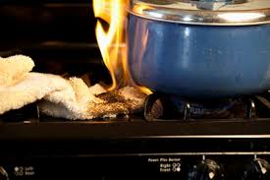
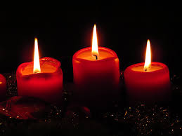
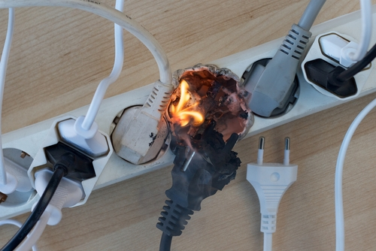
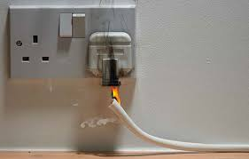
Cookers Candles
Frayed Electric Cable Overloading Plugs

Slide 8
Cubs what are the Safety Rules Before and When fire is Lit

Slide 9
Campfires
Look Up and Around Ensure no Overhanging Branches
Only Light Fire on a Fire Alter or in a Fire Barrel
Keep Bucket of Water Nearby
Keep people back at least 2m
Keep Chopping Area and Wood Pile Well Away From Fire
Always Watch Young People
Ensure Fire has no Fresh Wood on it and has Burned Down or is Below lip of Barrel
When Fire is Finish for Camp Pour Water over it Till no Heat Rises (if barrel take to Ash Bin)

Slide 10
Ask Cubs What is the Safe Way to Use Fireworks

Slide 11
Safety Rules for Fireworks

Slide 12
Firework Safety
Always buy from a LICENCED retailer.
Never put fireworks in your pocket.
Do not set fireworks off in the street or other public places; it is against the law. Never throw fireworks; it is dangerous.
Keep pets indoors.
Light fireworks one at a time at arm’s length, at the end of the fuse, using a safety firework lighter
Never go back to a lit firework
Never throw spent fireworks on a bonfire

Slide 13
Ask the Cubs for Some Safety Rules Around a Bonfire

Slide 14
Safety Rules Around Bonfires
Sa

Slide 15
Site the bonfire well away from houses, garages, sheds, fences, overhead cables, trees and shrubs AND ALWAYS AWAY FROM FIREWORKS
Build the stack so that it is stable and will not collapse outwards or to one side
NEVER use flammable liquids - paraffin or petrol - to light the fire
Don't burn foam-filled furniture, aerosols, tins of paint and bottles
Keep everyone away from the fire - especially children, who must be supervised all the time
For an emergency keep buckets of water or the garden hose or a fire extinguisher ready
Pour water on the embers before leaving
Keep people well back from the fire

