Slide 1
Personal Safety – Firework Code and Water Safety Code

Slide 2
FIREWORK SAFETY CODE -
Do you know what it is?

Slide 3
THE FIREWORKS SAFETY CODE
Only buy fireworks marked – BS 7114.
Keep fireworks in a closed box.
Follow the instructions on each firework.
Light them at arm’s length, using a taper.
Stand well back.
NEVER go near a firework that has been lit. Even if it hasn’t gone off, it could still explode.
NEVER put fireworks in your pocket or throw them.

Slide 4
continued……
Always supervise children around fireworks.
Light sparklers one at a time and wear gloves.
Never give sparklers to children under five.
Keep pets indoors.
Don’t set off noisy fireworks late at night.

Slide 5
WATER SAFETY CODE

Slide 6
As soon as you arrive at the beach, check what safety flags are flying.
This Photo by Unknown Author is licensed under CC BY-ND

Slide 7
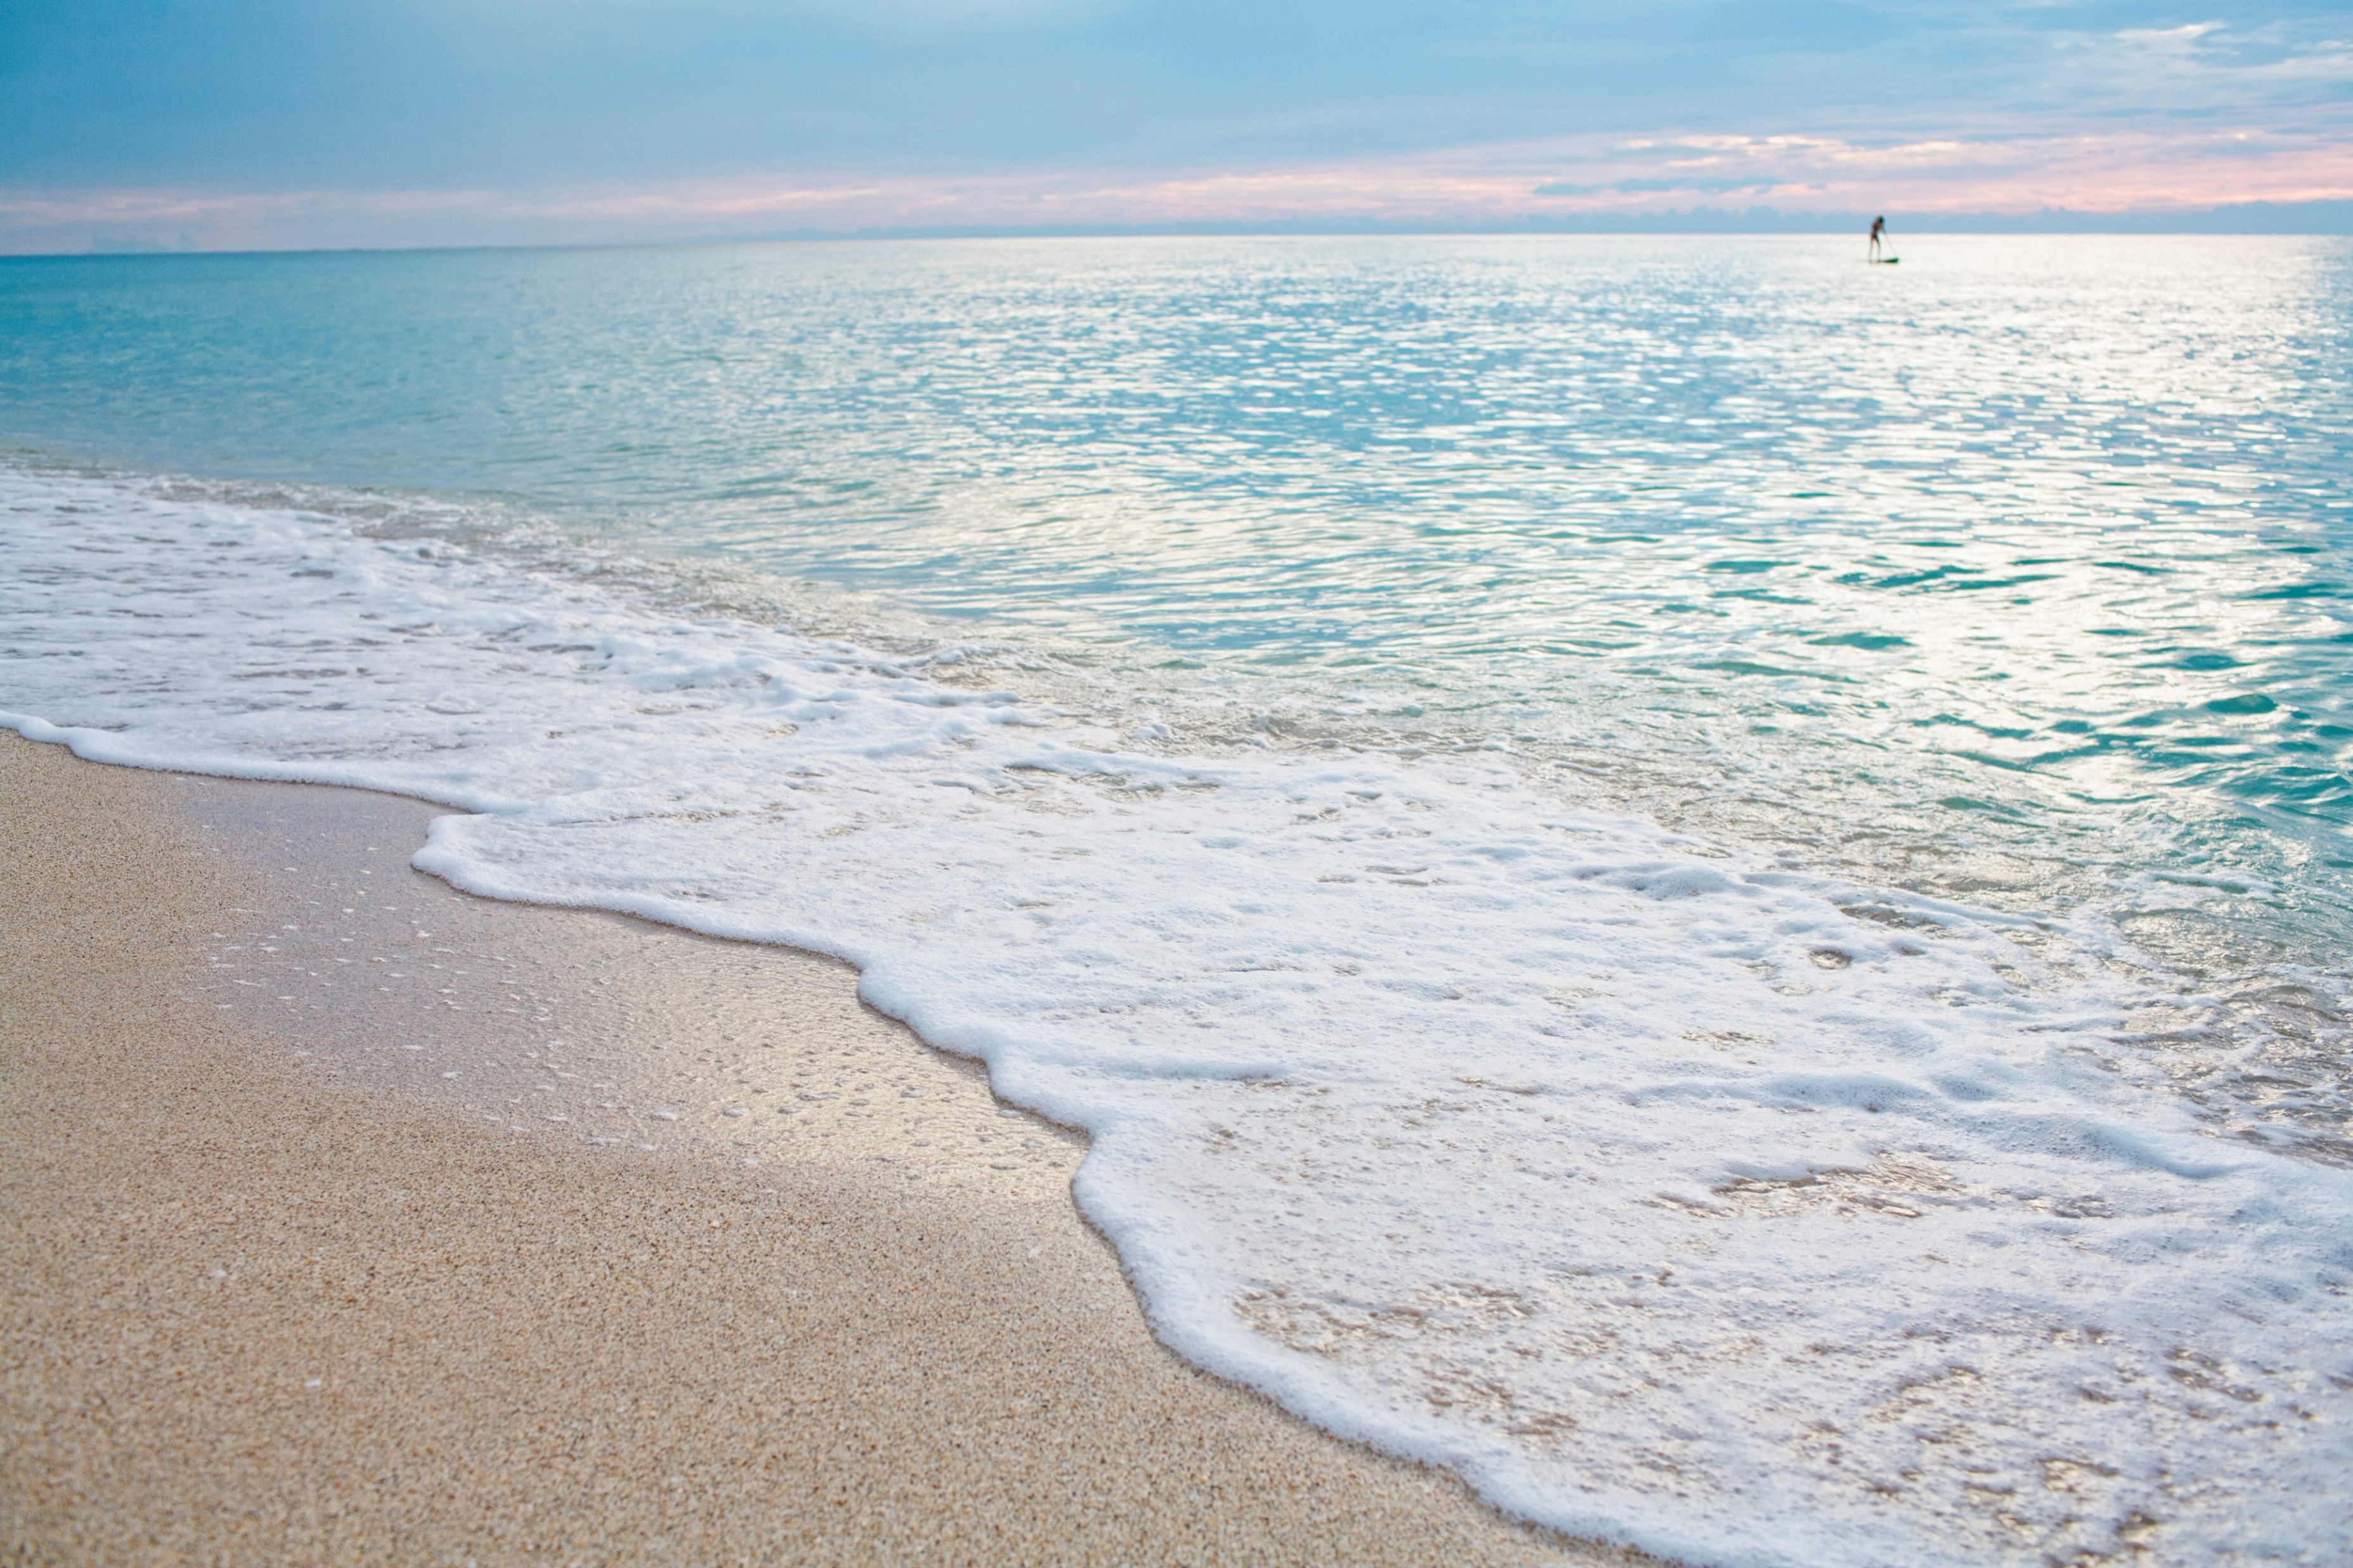
STAY SAFE AT THE SEASIDE – Swimming and strong currents: Our coast has some very strong tides and currents (sometimes called rips). They are strong currents running out to sea that can quickly take a swimmer from shallow water into danger. For safety’s sake always swim between the flags.
Always swim parallel to the shore.
Don’t go out of your depth.
Even strong swimmers cannot swim against strong currents.

Slide 8
SURFING AND BODY BOARDING
Make sure you are a confident and strong swimmer.
Follow advice from the lifeguard.
Do it within your own ability.
Don’t go alone.
Do surfing or bodyboarding between the black and white chequered flags.
Consider others around you.

Slide 9
USING INFLATABLES AT THE SEASIDE – These can be dangerous. The slightest offshore breeze can blow you out to sea.
Make sure the inflatable is between the red and yellow flag.
Make sure you follow the advice of the lifeguard.
Always have a line attached to an adult on the shore.
NEVER use an inflatable when there are strong winds.

Slide 10
If you get into trouble swimming or surfing/body boarding in a current:
Keep calm.
Raise your hand and indicate that you are in trouble.
Shout for help.
Hold onto your surf/body board.
Try and swim parallel to the beach, until you are out of the current. Then swim to the shore.
If you can stand up, wade instead of swimming.

Slide 11
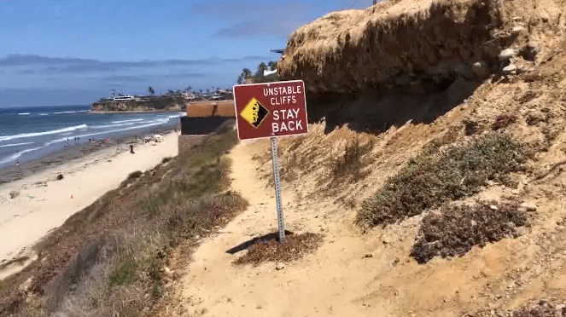
OTHER HAZARDS
Getting cut off by the tide.
Weather conditions and tide times.
Man-made hazards.
Cliffs and rocks.

Slide 12
Can you spot what’s wrong?

Slide 13
At the seaside, remember to always think ‘SAFE’
S – Spot the dangers
A – Always go with at least one other person.
F – Find and read the safety signs and flags.
Emergency! Stick your hand up and shout. Tell a lifeguard or dial 999 for the Coastguard.

Slide 14
STAY SAFE!

