Slide 1
PERSONAL SAFETY Railways & Roads
When you are out and about, taking part in adventures, keeping yourself safe is a must.

Slide 2
Explain the dangers of playing on or near a railway.

Slide 3
Here are some examples.
Putting objects on train tracks is dangerous.
Throwing things at trains is dangerous.
Going into train tunnels is dangerous.
At crossings, when warning lights turn amber or red lights are flashing, you must ALWAYS stop and wait.
If you have a dog, keep it on a lead.
Some crossings don’t have flashing lights or barriers. Stop and listen. DO NOT cross if you see or hear trains.
Always think about what you are doing. NEVER get distracted.
DO NOT go around barriers that are down to cross the track.
Walk bikes across the track.

Slide 4
ELECTRICITY
Overhead cables carry 25,000 volts of electricity and can jump 3m away from cables.
Never dangle objects from railway bridges, or perhaps be flying a kite, balloon or flying a drone near overhead cables. Electricity would travel through anything you are holding so it can reach the ground – you could be killed or suffer serious burns.
Electricity running by a third rail on the track carries 750 volts of electricity. It is very dangerous and can kill you as it is still more powerful than electricity in your home.

Slide 5
DID YOU KNOW?
Electricity in the third rail is never turned off.
The average passenger train weighs approximately 400 tonnes.
Trains can travel up to 125mph and can take an average of 20 football pitches to stop.
The train driver cannot swerve to miss you!!

Slide 6
Explain the dangers of busy roads.

Slide 7
Here are some examples.
Walking too close to the kerb.
Be Safe, Be Seen! It is difficult for a driver to see you in the dark or bad weather. Fluorescent materials show up in daylight and dusk. Wear or carry something reflective at night.
Not following the Green X Code. Find a safe place to cross. Stop, look and listen. Walk straight across the road when it is safe to do so. Keep looking and listening.
DO NOT run around near a busy road, you may trip and fall into the road.
DO NOT play ball games while on the path.
DO NOT ignore using crossings – zebra crossing, pelican crossing, an island in the road and at traffic lights.
Ride your bike correctly, using bike lanes where they are marked.

Slide 8
CAN YOU SPOT THE DANGERS!

Slide 9
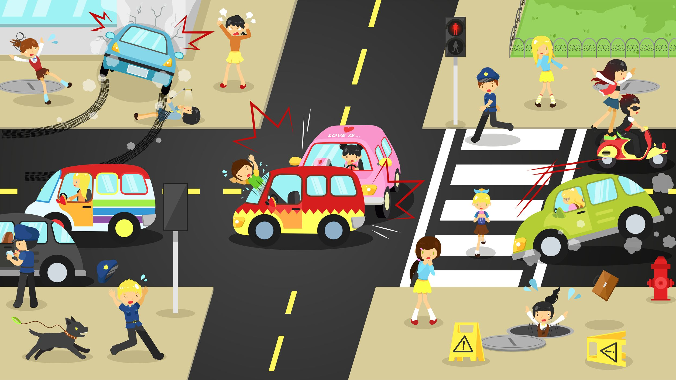

Slide 10
Think about dangers on:
Building sites
Farmyards
Lakes
Canal banks
Cliffs
Sand

Slide 11
STAY SAFE!!

