Slide 1
Emergency Aid

Slide 2
Watch video: https://www.youtube.com/watch?v=St19GmgIJFY
Dealing with Bleeding
Clean the cut and pat the wound dry
Put pressure on the wound
Put on disposable gloves, if available
If possible, tell an adult
Check it’s safe to help
Cover with a plaster or adhesive dressing
Ask the injured person if they’re OK and comfort them

Slide 3
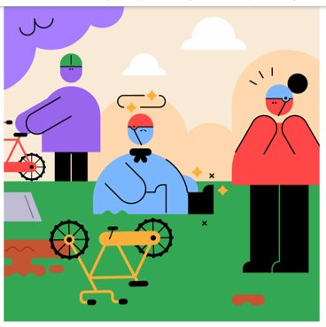
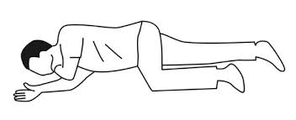
Dealing with someone
who is unconscious
Shake them
Point and laugh at them.
Ask the injured person if they’re OK and comfort them
Check it’s safe to help
Ask someone to ring 999
Put them in the recovery position
Run away and pretend not to have seen anything.
If possible, tell an adult
Watch video: https://www.youtube.com/watch?v=TRQePNmR66w&t=6s

Slide 4
When to call 999
I have seen a car accident
Someone has broken their leg
YES
Someone has fallen off their bike and is crying
I have a headache
NO
There is a fire
I have a cut on my arm
Someone has fallen over and I can't wake them up
Someone is not breathing

Slide 5
First Aid Kit Memory Game

Slide 6
Quiz
https://www.greenboxfirstaidtraining.co.uk/first-aid-quizes-for-scouts

