Slide 1
Navigator Staged Badge 1

Slide 2
Map Symbols
These are used to pinpoint places of interest on a map
How many are there???
There’s:
28 Map Symbols &
83 Abbreviations

Slide 3
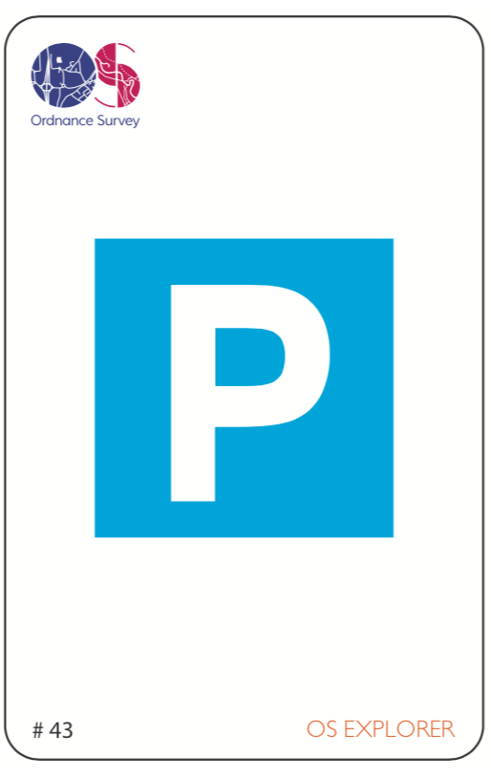
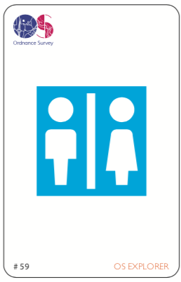
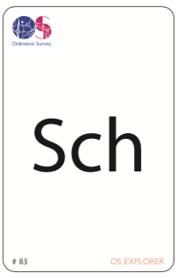
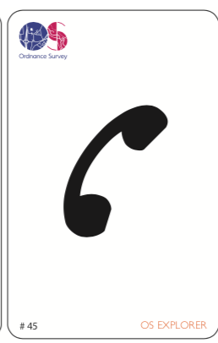
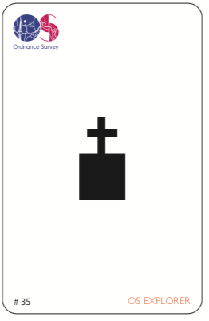
Parking
Public Toilets
School
Non-coniferous Wood
Train Station
Public Telephone
Place of worship
Place of worship with tower
Information Point
Public House

Slide 4
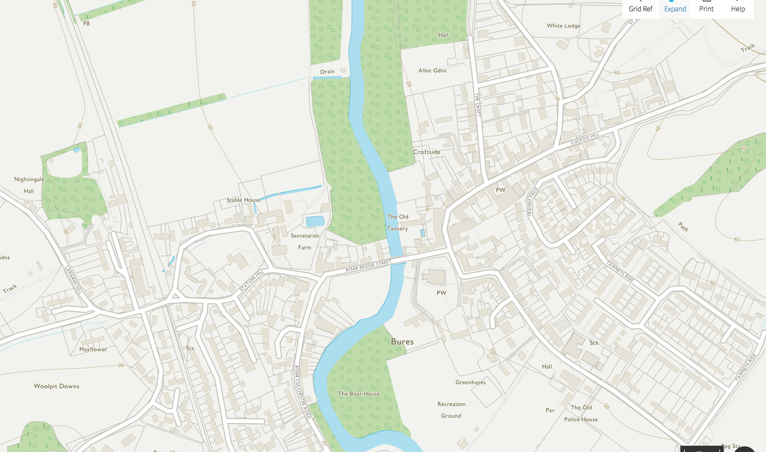

Slide 5
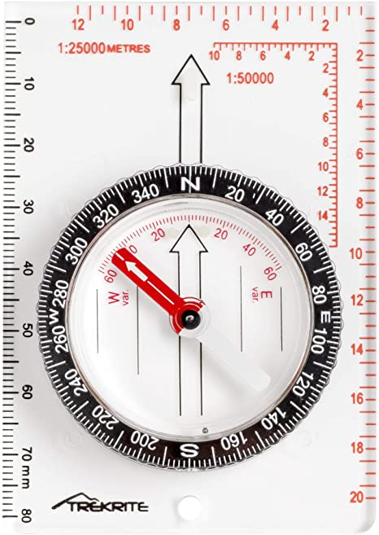
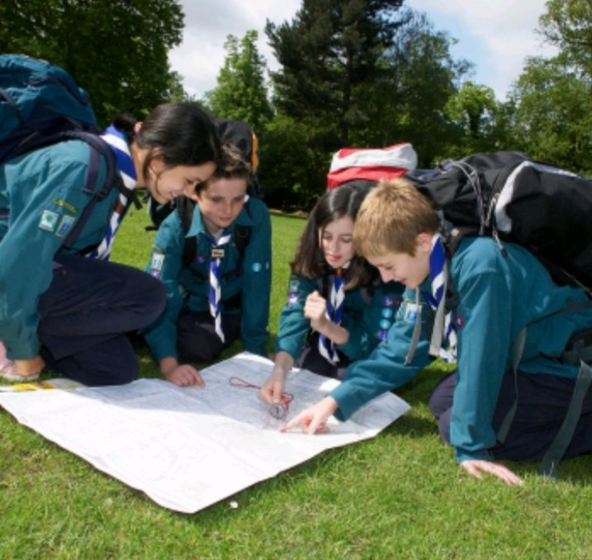
What are the 4 points of a Compass?
What is a Compass??

Slide 6
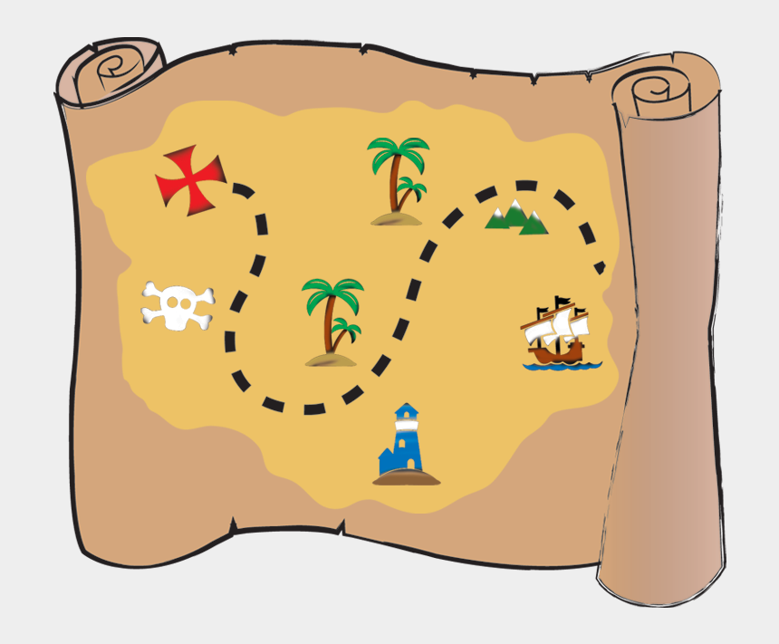
Draw a simple map….
Of where you live, your meeting place (scout hut) or another area local to you.

Slide 7
What Clothing and Equipment should you bring on a Hike?
Waterproofs
Food!!
Map
Emergency Foil Blanket
Walking Boots
Water
Emergency Whistle
First Aid Kit
Compass
Torch
Warm Clothes

