Slide 2
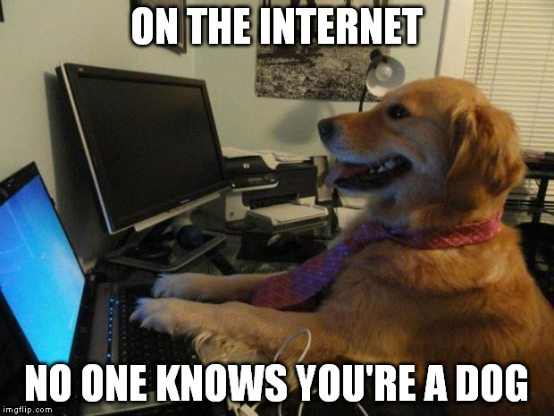
People are not always who they seem to be … …especially online

Slide 3
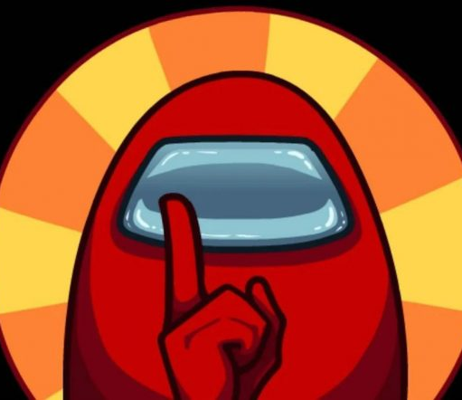
Do you know who you’re playing with?
Friends?
Friends of Friends?
Friends of Friends of Friends?
Strangers?
Ask a parent before messaging someone you don’t know well in real life

Slide 4
Don’t Share…
Full name
Address
Age / birthday
School
Email address
Phone number
Passwords
Personal and family details
Assume anything you share will be online forever
Notes:
– think carefully whether there is anyone you wouldn’t want to see what you share/post/send/type – if there is then don’t do it.

Slide 5
Games & Social Media
Use a gaming handle – not your real name
Keep your chat about the game
Report inappropriate behaviour in the app
Ask before buying extras
Beware free gaming credits – scams
make sure you’re not the bully!
Notes:
People can be much less careful about the feelings of others when they aren’t in the room - don’t allow bullying and don’t become a bully yourself – in chat and text your cheeky comments can easily be misinterpreted. Treat everyone like you’d treat your grandparents. Treat everyone with respect – Be kind to noobs
Talk to someone
Dealing with trolls – report, don’t engage. don’t amplify their voice
Ask your parents before purchasing skins, bonus features and extras
Be very sceptical of strangers – especially those who are always complimenting you or trying to give you gifts to get you to trust them.

Slide 6
Think before you click:
You wouldn’t go down a dark alley alone; take the same care online
If something seems not quite right then check with an adult
If you see something that makes you uncomfortable:
Tell a parent or trusted adult immediately
Don’t respond or try to click it away
Don’t be embarrassed - mistakes happen
Seen something upsetting?

Slide 7
Dodgy Downloads?
attachments, downloads, mods and resource packs
Beware of free stuff
may contain viruses or scams
which delete your files, break your device, install spyware or demand money
Check with a responsible adult

Slide 8
Quiz Time!

Slide 9
Question 1
Which of these would be the best password?
Tomstalbans2011
Password1234
monk3y ch1psh0p balcony*
fortnite4ever

Slide 10
Question 2
Another player in your game starts swearing at you and trying to get others to gang up on you.
What do you do?
Argue back in the chat?
Report the player and mute them?
Do everything you can to ruin their game?

Slide 11
Question 3
You click on a link to a page and see something which makes you uncomfortable. Do you:
Send it to a friend to see what they think?
Quickly close the computer and act like nothing happened?
Look away and fetch your parents?

Slide 12
Question 4
You fall out with your best friend at school. Is it a good idea to share a message to tell everyone what an idiot they are?
Yes
No

Slide 13
Question 5
An online quiz says your cowboy name is the colour of your front door and the name of your street. It asks you to type the answer.
Should you continue with the quiz?
Yes
No

Slide 14
Question 6
You want a cool skin for your character but it costs 1000 Robux. Do you:
Ask your parents?
Click an advert for 10000 free Robux?
Borrow your Mum’s credit card when she’s not looking?

Slide 15
Question 7
Your schoolfriend wants to play Minecraft with you after school. What’s the best way to arrange this?
Get them to ask their parents to send your parents an invitation
Turn off the privacy settings so that your friend can search for you online
Look out for someone with the same name on a public server.

Slide 16
Remember…
Involve your parents
Don’t give away your personal information
Think before you click
Beware free stuff
Use good passwords
Don’t be the bully!
Have Fun!

