Slide 1
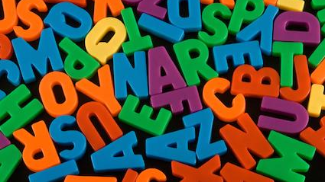
The Pointless Alphabet Game

Slide 2
(Write your answer down, don’t say it out loud)
Super Hero
Beginning with the letter
S

Slide 3
I choose
Spiderman
Now take it in turns to read out what we have written.
If someone else has the same as you then you both cross it out.
Once everyone has shared their chosen word anyone who still has their word gains one point
Who will have the most points in the end

Slide 4
Now it’s your turn

Slide 5
Animals you see
at the zoo
Beginning with the letter
P

Slide 6
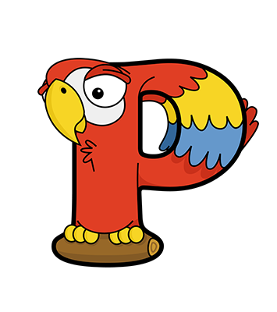
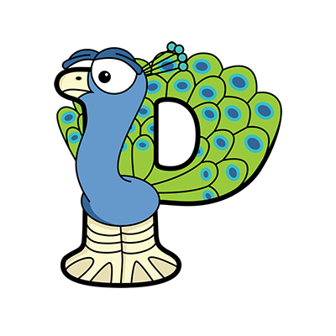
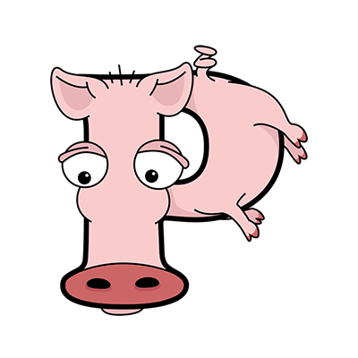
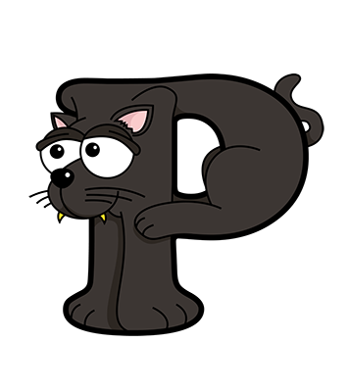
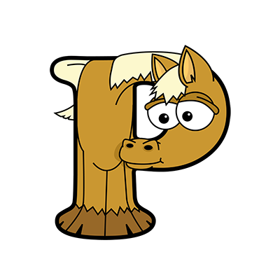
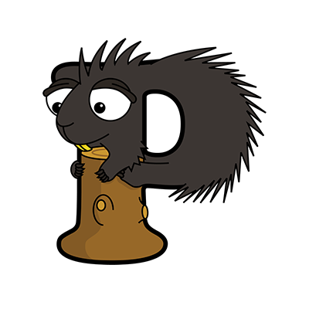
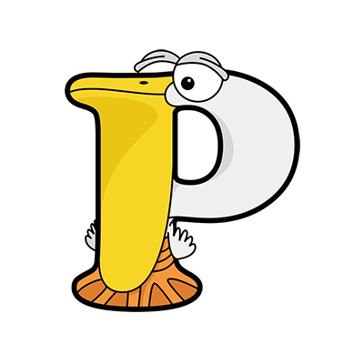
Panda, Panther, Parakeet, Parrot, Partridge, Peacock, Peccary, Pelican, Penguin, Pheasant, Pig, Pigeon,
Pika, Pike, Piranha, Platypus, Poison Dart Frog, Polar Bear, Polecat, Porcupine, Prairie Dog, Prawn,
Praying Mantis, Proboscis Monkey, Puff Adder, Puffer Fish, Puffin, Puma, Python

Slide 7
Something you have for breakfast
Beginning with the letter
C

Slide 8
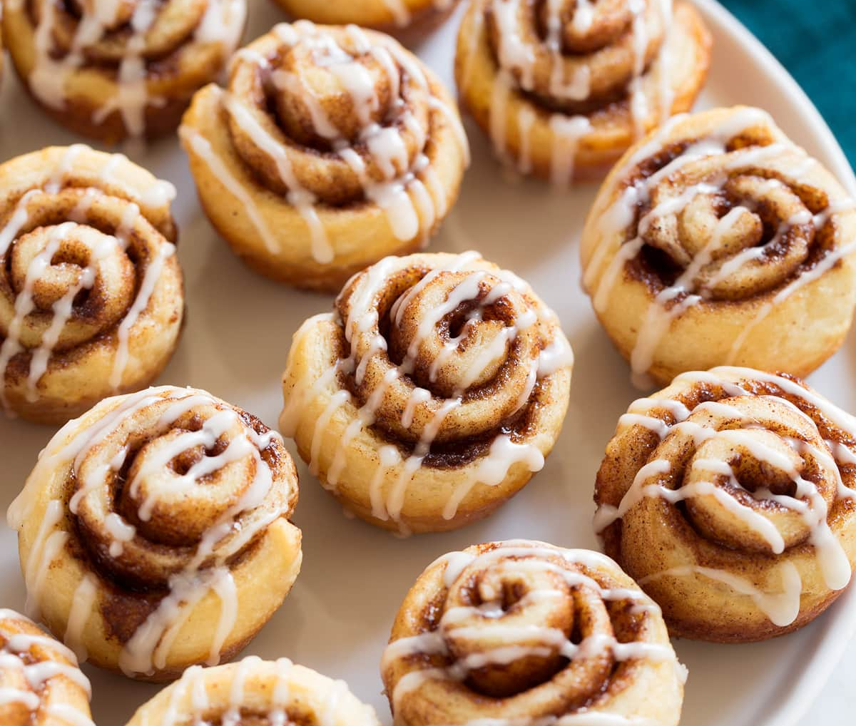
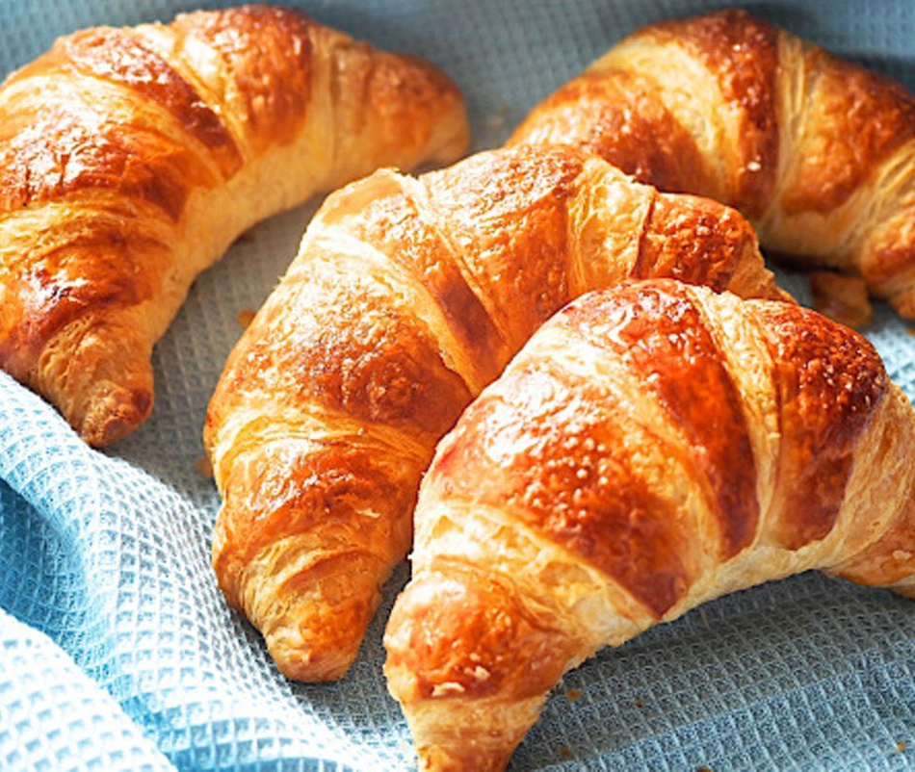
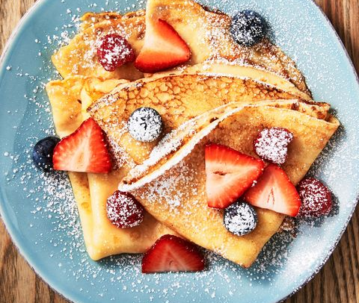
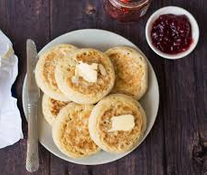
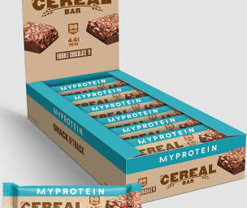

Slide 9
Sports and Hobbies
Beginning with the letter
R

Slide 10
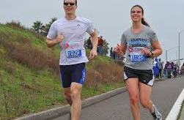
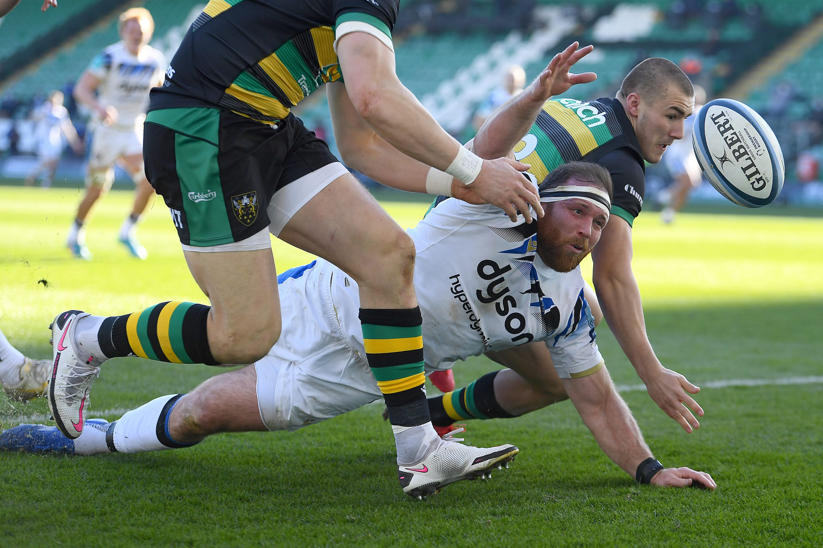
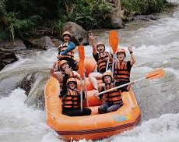
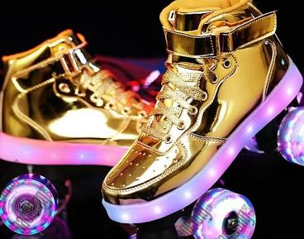

Slide 11
Something you find in the kitchen
Beginning with the letter
S

Slide 12
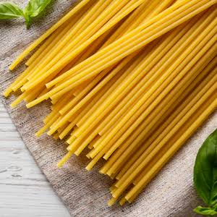
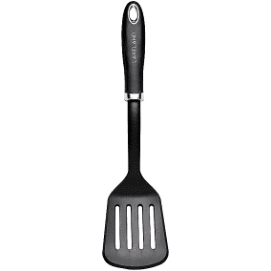
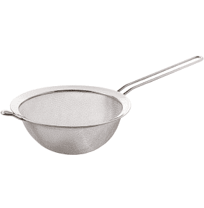
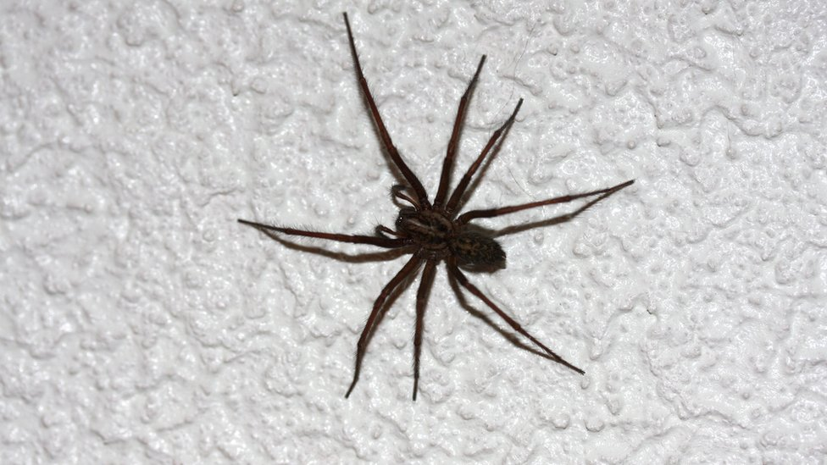

Slide 13
Things you might like to do at the weekend
Beginning with the letter
W

Slide 14
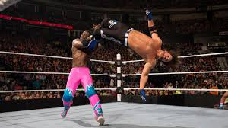
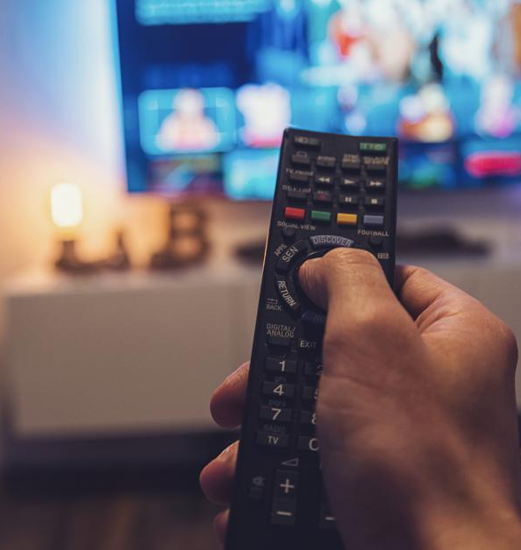
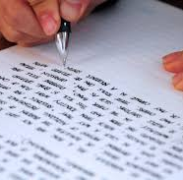

Slide 15
Four letter word
Beginning with the letter
L

Slide 16
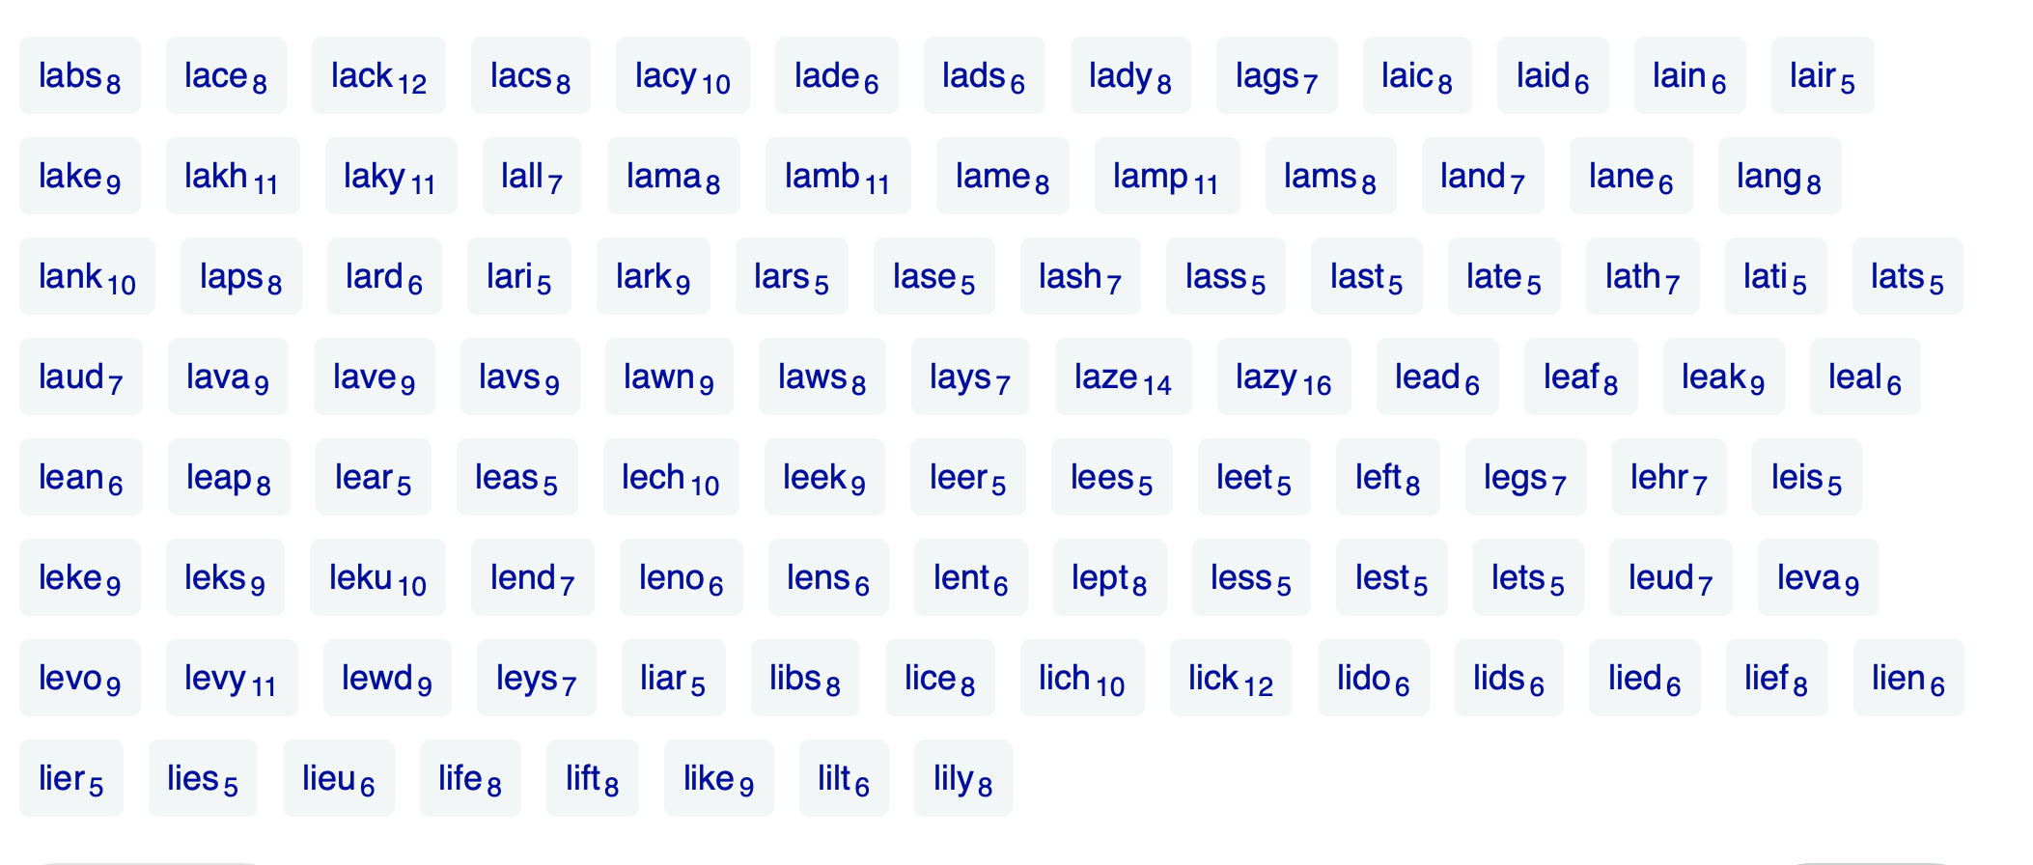

Slide 17
Farm Animal
Beginning with the letter
C

Slide 18
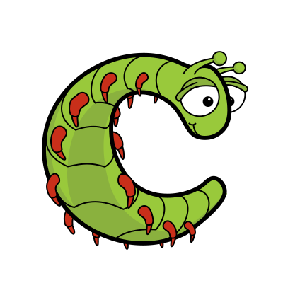
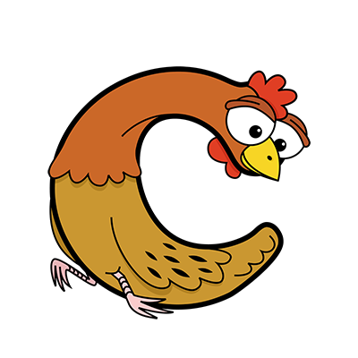
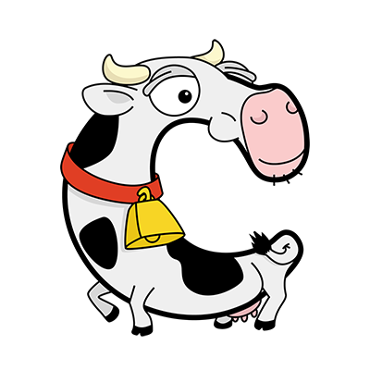
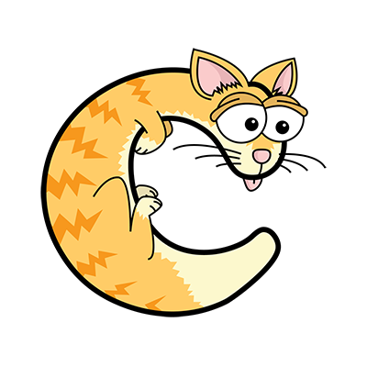

Slide 19
At school
Beginning with the letter
M

Slide 20
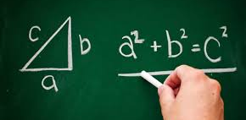
Marine Science
Mathematics
Media Studies
Modern Hebrew
Moving Image Arts
Music
Music Technology
Mandarin

Slide 21
In the bathroom
Beginning with the letter
B

Slide 22
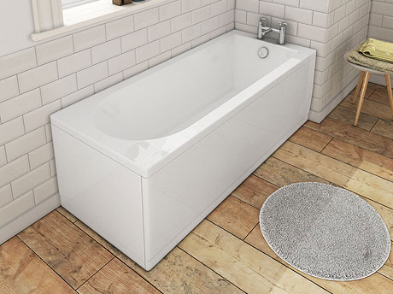
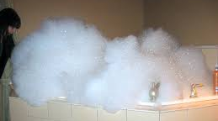
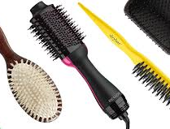

Slide 23
Games
Beginning with the letter
S

Slide 24
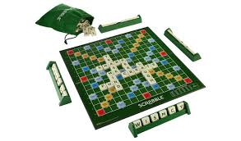
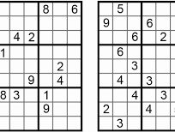
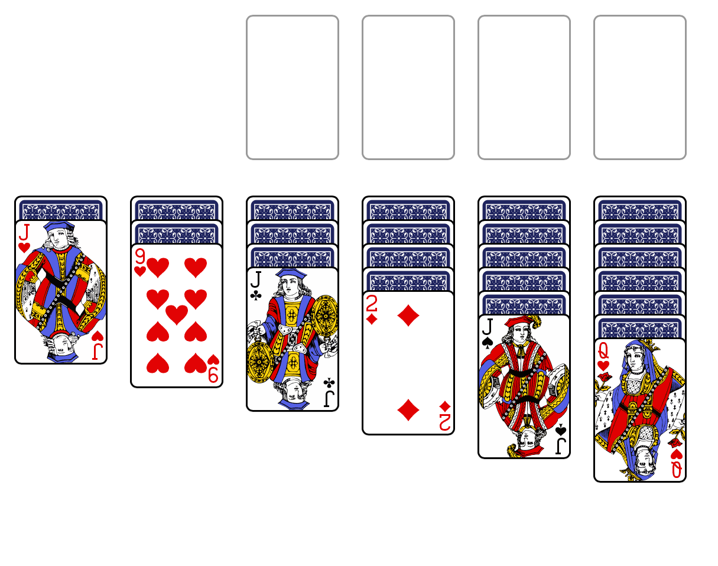
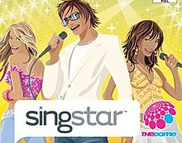

Slide 25
In the fridge
Beginning with the letter
B

Slide 26
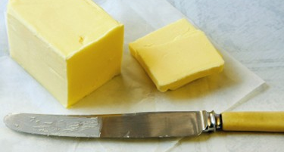
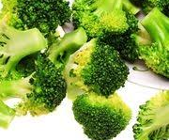
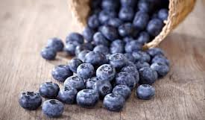
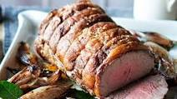

Slide 27
Chocolate
Beginning with the letter
C

Slide 28
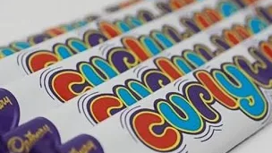
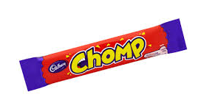

Slide 29
Colours
Beginning with the letter
P

Slide 31
Cars
Beginning with the letter
A

Slide 32
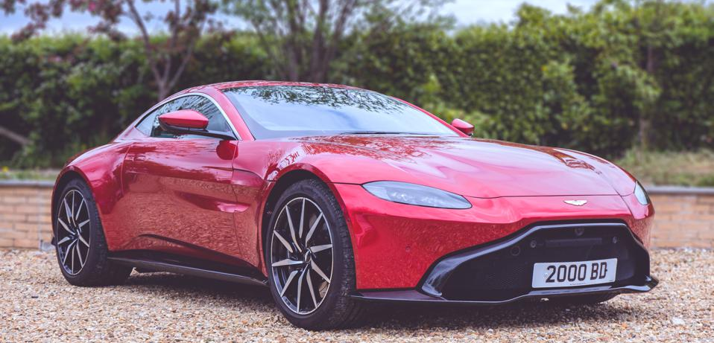
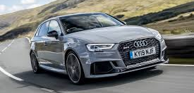
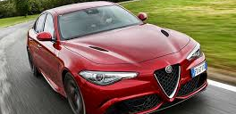

Slide 33
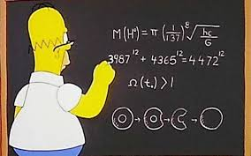
Now add up your score

